Slide 1
Stitching Things Together
Dan Kohn, CNCF Executive Director
@dankohn1
May 21, 2019
Notes:
[Speaker notes (other than info in brackets) are the script. Presentation takes ~12 minutes. To get just the script, choose File: Download as Plain Text and in a regex-capable editor like Sublime Text, replace (^\n)|^[^#].*\n and then # ? with nothing.]
# Good morning!
#

Slide 2





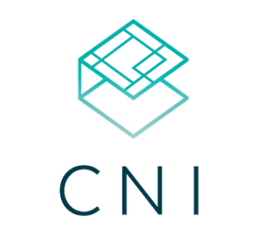








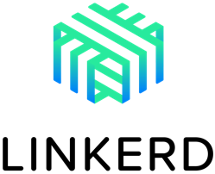







CNCF Hosted Projects
Notes:
# I’m Dan Kohn, executive director of CNCF, the nonprofit organization that hosts these open source projects and organizes this event.
#

Slide 3
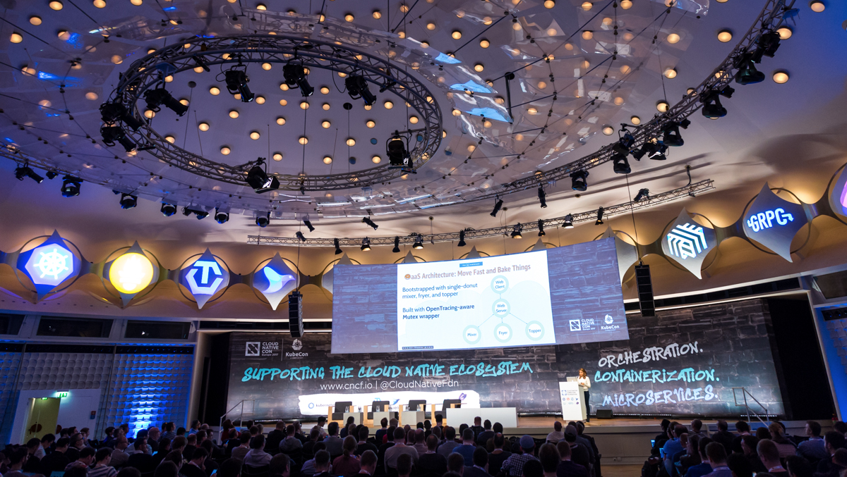

3
Notes:
# Here’s a picture of our much smaller conference 2 years ago in Berlin. Let’s zoom in on the graffiti...
#

Slide 4
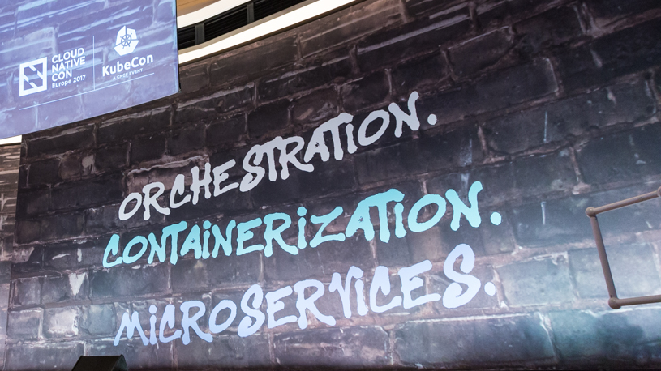
4
Notes:
# Orchestration, Containerization, Microservices... Our shorthand for explaining cloud native. Last year, our Technical Oversight Committee came up with a much more expansive characterization:
#

Slide 5
CNCF Cloud Native Definition v1.0
CNCF Cloud Native Definition v1.0
Cloud native technologies empower organizations to build and run scalable applications in modern, dynamic environments such as public, private, and hybrid clouds. Containers, service meshes, microservices, immutable infrastructure, and declarative APIs exemplify this approach.
These techniques enable loosely coupled systems that are resilient, manageable, and observable. Combined with robust automation, they allow engineers to make high-impact changes frequently and predictably with minimal toil.
The Cloud Native Computing Foundation seeks to drive adoption of this paradigm by fostering and sustaining an ecosystem of open source, vendor-neutral projects. We democratize state-of-the-art patterns to make these innovations accessible for everyone.
Notes:
# The CNCF Cloud Native Definition version 1.0. It includes ideas like...
#

Slide 6
CNCF Cloud Native Definition v1.0
CNCF Cloud Native Definition v1.0
Cloud native technologies empower organizations to build and run scalable applications in modern, dynamic environments such as public, private, and hybrid clouds. Containers, service meshes, microservices, immutable infrastructure, and declarative APIs exemplify this approach.
These techniques enable loosely coupled systems that are resilient, manageable, and observable. Combined with robust automation, they allow engineers to make high-impact changes frequently and predictably with minimal toil.
The Cloud Native Computing Foundation seeks to drive adoption of this paradigm by fostering and sustaining an ecosystem of open source, vendor-neutral projects. We democratize state-of-the-art patterns to make these innovations accessible for everyone.
Notes:
# ...declarative APIs...
#

Slide 7
CNCF Cloud Native Definition v1.0
CNCF Cloud Native Definition v1.0
Cloud native technologies empower organizations to build and run scalable applications in modern, dynamic environments such as public, private, and hybrid clouds. Containers, service meshes, microservices, immutable infrastructure, and declarative APIs exemplify this approach.
These techniques enable loosely coupled systems that are resilient, manageable, and observable. Combined with robust automation, they allow engineers to make high-impact changes frequently and predictably with minimal toil.
The Cloud Native Computing Foundation seeks to drive adoption of this paradigm by fostering and sustaining an ecosystem of open source, vendor-neutral projects. We democratize state-of-the-art patterns to make these innovations accessible for everyone.
Notes:
# ...resiliency...
#

Slide 8
CNCF Cloud Native Definition v1.0
CNCF Cloud Native Definition v1.0
Cloud native technologies empower organizations to build and run scalable applications in modern, dynamic environments such as public, private, and hybrid clouds. Containers, service meshes, microservices, immutable infrastructure, and declarative APIs exemplify this approach.
These techniques enable loosely coupled systems that are resilient, manageable, and observable. Combined with robust automation, they allow engineers to make high-impact changes frequently and predictably with minimal toil.
The Cloud Native Computing Foundation seeks to drive adoption of this paradigm by fostering and sustaining an ecosystem of open source, vendor-neutral projects. We democratize state-of-the-art patterns to make these innovations accessible for everyone.
Notes:
# ...observability...
#

Slide 9
CNCF Cloud Native Definition v1.0
CNCF Cloud Native Definition v1.0
Cloud native technologies empower organizations to build and run scalable applications in modern, dynamic environments such as public, private, and hybrid clouds. Containers, service meshes, microservices, immutable infrastructure, and declarative APIs exemplify this approach.
These techniques enable loosely coupled systems that are resilient, manageable, and observable. Combined with robust automation, they allow engineers to make high-impact changes frequently and predictably with minimal toil.
The Cloud Native Computing Foundation seeks to drive adoption of this paradigm by fostering and sustaining an ecosystem of open source, vendor-neutral projects. We democratize state-of-the-art patterns to make these innovations accessible for everyone.
Notes:
# ...an ecosystem of open source, vendor-neutral projects.
#

Slide 10

CNCF Cloud Native Definition v1.0
CNCF Cloud Native Definition v1.0
Cloud native technologies empower organizations to build and run scalable applications in modern, dynamic environments such as public, private, and hybrid clouds. Containers, service meshes, microservices, immutable infrastructure, and declarative APIs exemplify this approach.
These techniques enable loosely coupled systems that are resilient, manageable, and observable. Combined with robust automation, they allow engineers to make high-impact changes frequently and predictably with minimal toil.
The Cloud Native Computing Foundation seeks to drive adoption of this paradigm by fostering and sustaining an ecosystem of open source, vendor-neutral projects. We democratize state-of-the-art patterns to make these innovations accessible for everyone.
Notes:
# One word that’s not included in the definition... is Kubernetes. That’s because Kubernetes is a *leading* cloud native implementation but *certainly not* the only one. [pause] So, why are we at KubeCon and *not* a conference about a different cloud native platform?
#

Slide 11


Notes:
# Or, more succinctly, why Kubernetes?
#

Slide 12
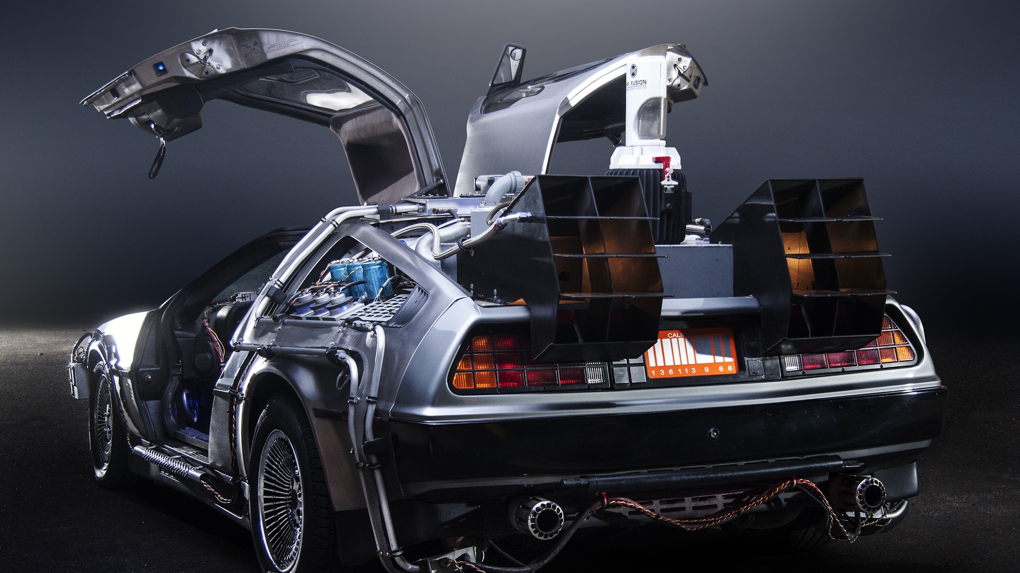
Notes:
# Let’s travel back in time a bit to look at the question of why certain technologies win out.
#

Slide 13
2004
Notes:
# We’ll start in the year 2004. A social networking entrepreneur met with a number of Silicon Valley investors, including Napster-founder Sean Parker.
#

Slide 14
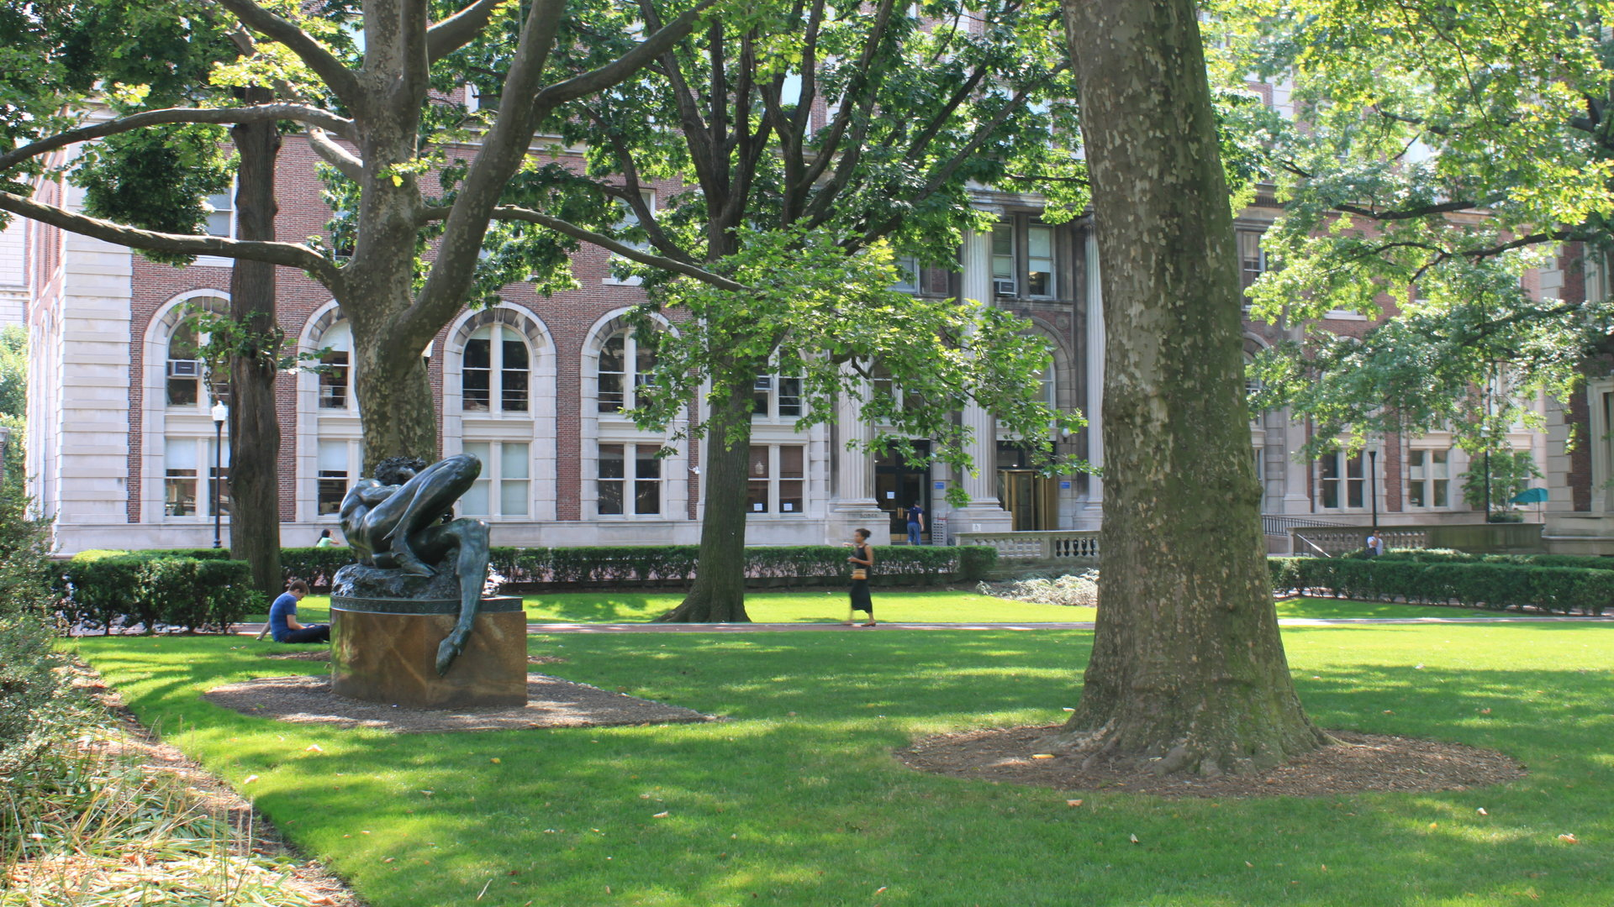
Notes:
# The founder launched at his Ivy League university, dropped out of school, and then expanded the social network to many other campuses, building the site to hundreds of thousands of users. [pause] I’m talking, of course, about...
#

Slide 15
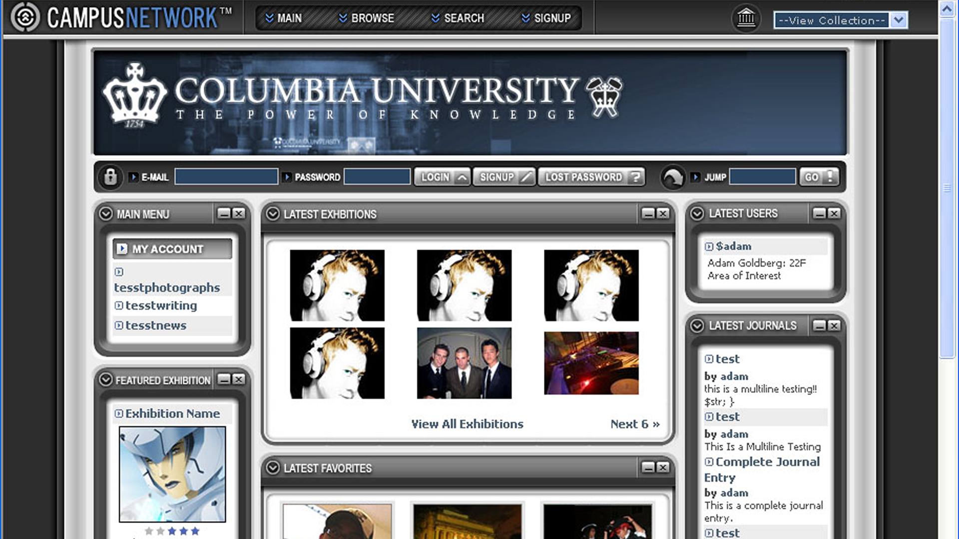
Notes:
# Campus Network, started at Columbia University by Adam Goldberg a month *before*... [pause]
#

Slide 16
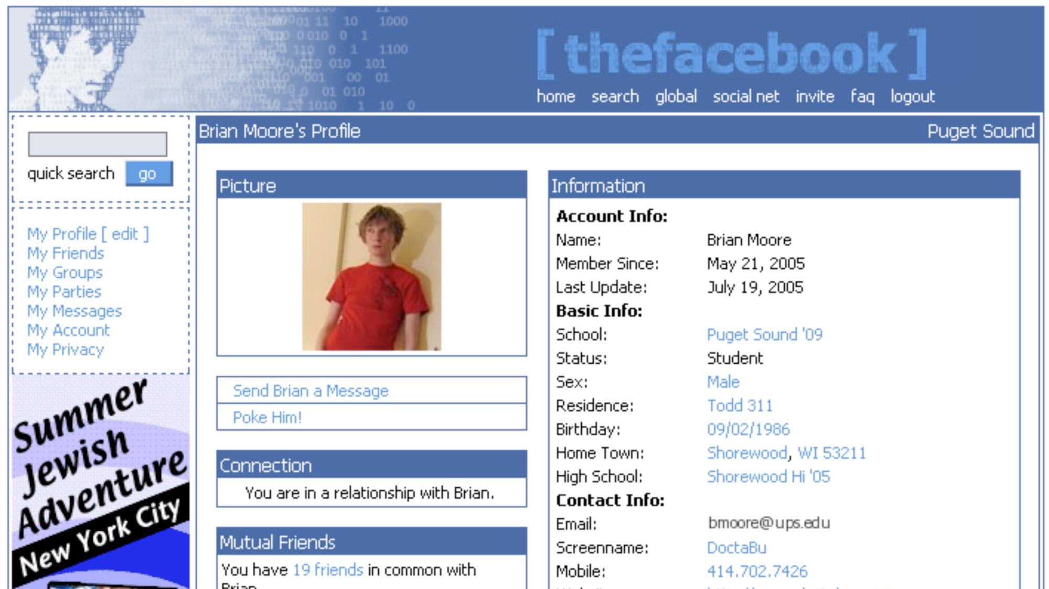
Notes:
# ...Mark Zuckerberg launched The Facebook at Harvard.
#

Slide 17
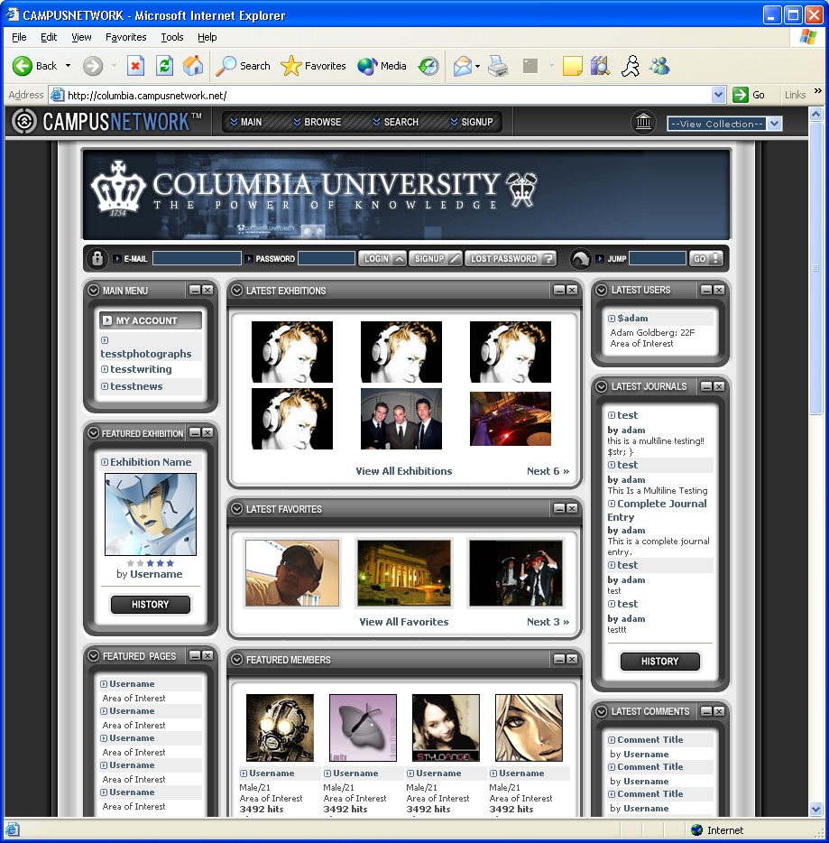
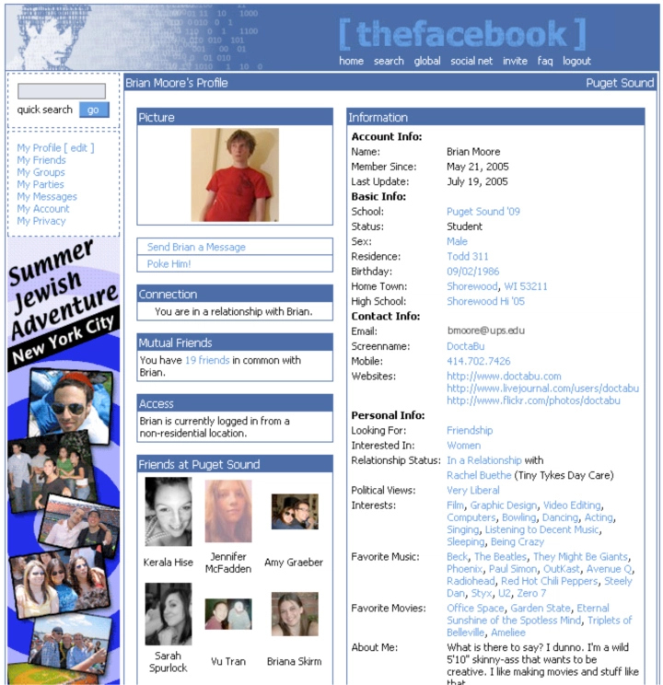
Notes:
# So, why were these two incredibly similar sites both developed at essentially the same time? [pause] I found my answer playing a game.
#

Slide 18

Notes:
# How many of you have ever played Sid Meier’s Civilization? [raise hand] Yeah, me too, and Civ 6 is my 12-year-old’s favorite game. One of Sid Meier’s greatest innovations was to explicitly map out a technology tree.
#

Slide 19
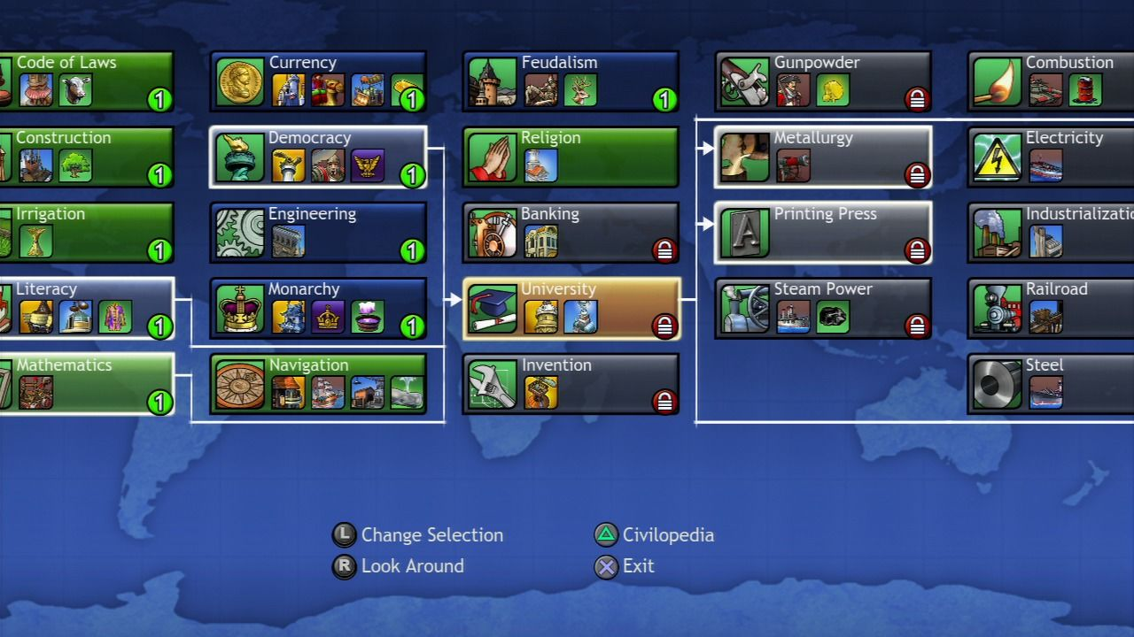
Notes:
# If you want to add knights as a warrior for your civilization, you need to have first developed the stirrup to domesticate horses and metalworking to create armor. The development of new technologies depends on the availability – and sometimes the ubiquity – of other technologies.
#

Slide 20
Notes:
# Both Campus Network and The Facebook depended on personal computers and the Internet being available in dorm rooms as well as a whole set of other technologies such as algorithms for efficient graph traversal.
#

Slide 21
Simultaneous Invention
Notes:
# And this process of simultaneous invention is something that we see throughout history.
#

Slide 22
1858
Notes:
# Let’s go back further in time to 1858.
#

Slide 23
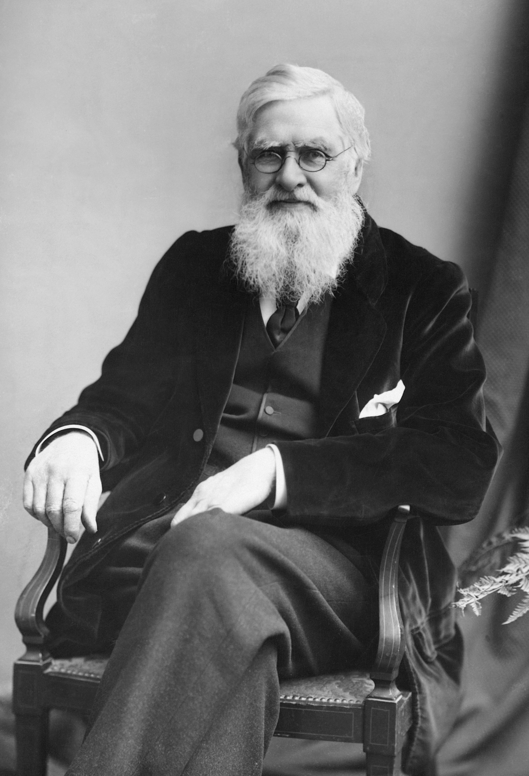
Notes:
# This is a picture of the British naturalist who collected beetles and spent his formative years as a scientist documenting the natural history of Wales. He went on a multi-year expedition in the mid-1800’s to collect specimens. After reading a book on population growth by Thomas Malthus, he formulated the theory of evolution.
#

Slide 24
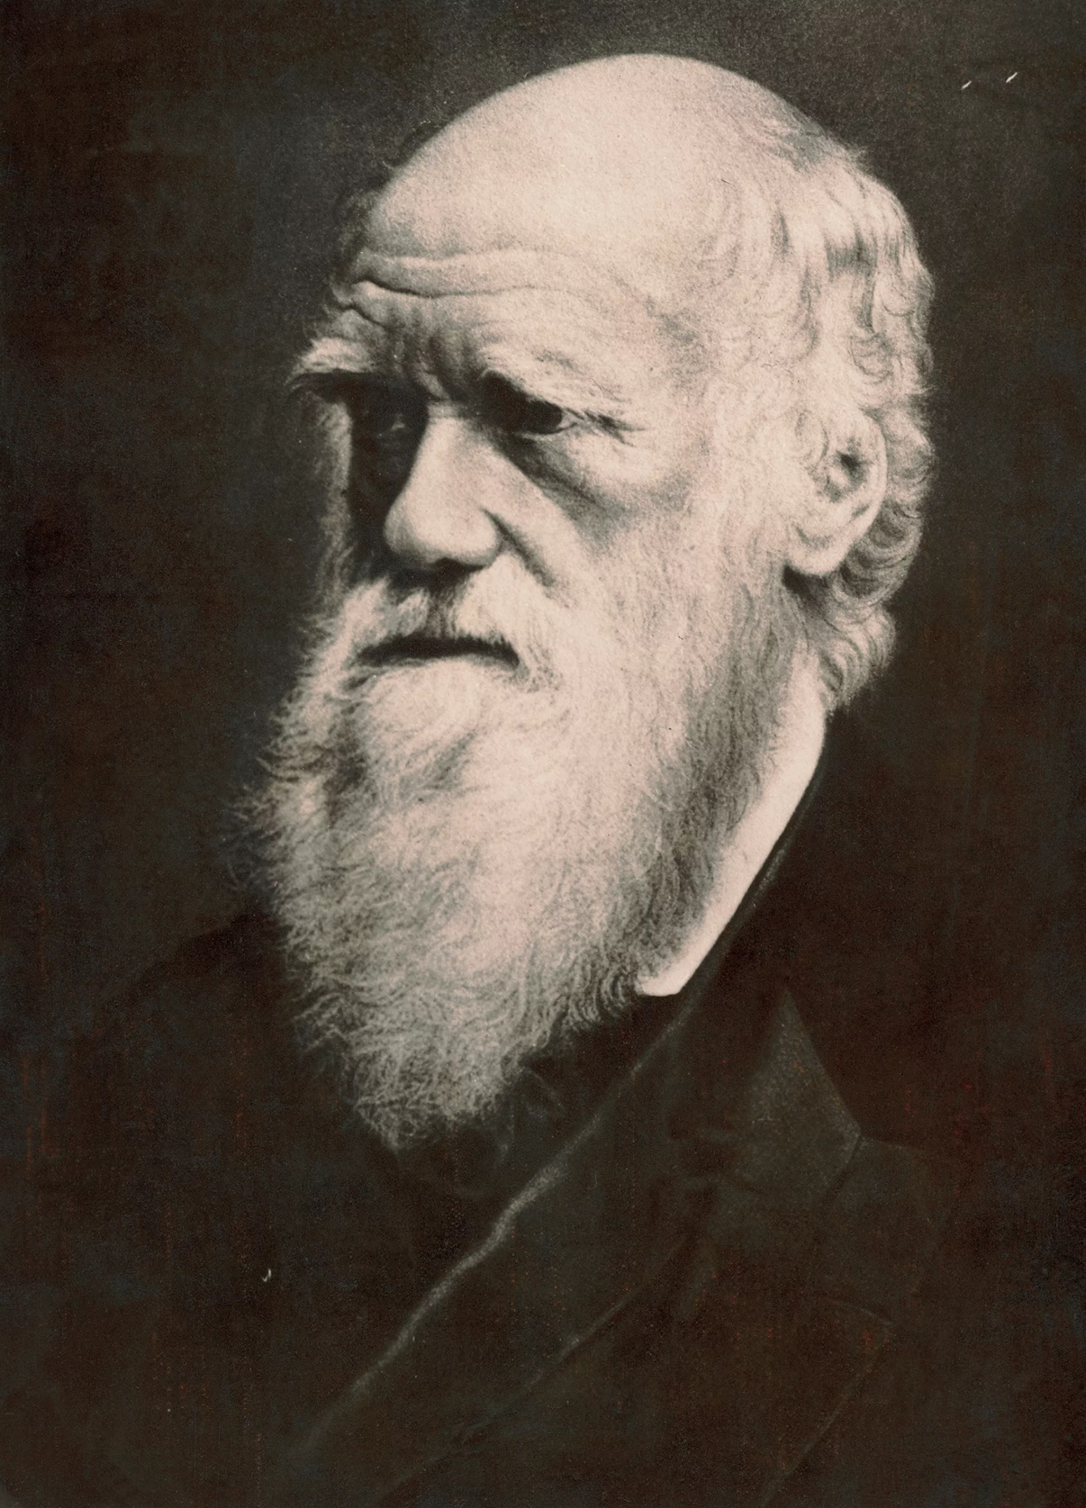
Notes:
# I’m *not* speaking of Charles Darwin, another British naturalist who collected beetles, studied Welsh natural history, went on a multi-year expedition and – 11 years earlier – after reading the same book by Malthus, discovered evolution.
#

Slide 25

Notes:
# No, the man on the left is Alfred Russel Wallace, and history knows him as “the other person who discovered evolution”.
#

Slide 26
“[T]his principle is exactly like that of the centrifugal governor of the steam engine, which checks and corrects any irregularities almost before they become evident; and in like manner no unbalanced deficiency in the animal kingdom can ever reach any conspicuous magnitude”
- Alfred Russel Wallace, 1858
Notes:
# Quote “The centrifugal governor of the steam engine checks and corrects any irregularities almost before they become evident; and in like manner no deficiency in the animal kingdom can ever reach any magnitude”. That’s Wallace describing “control theory”, which is central to how both evolution and Kubernetes work.
#

Slide 27
1687
Notes:
# We can go back further to 1687...
#

Slide 28
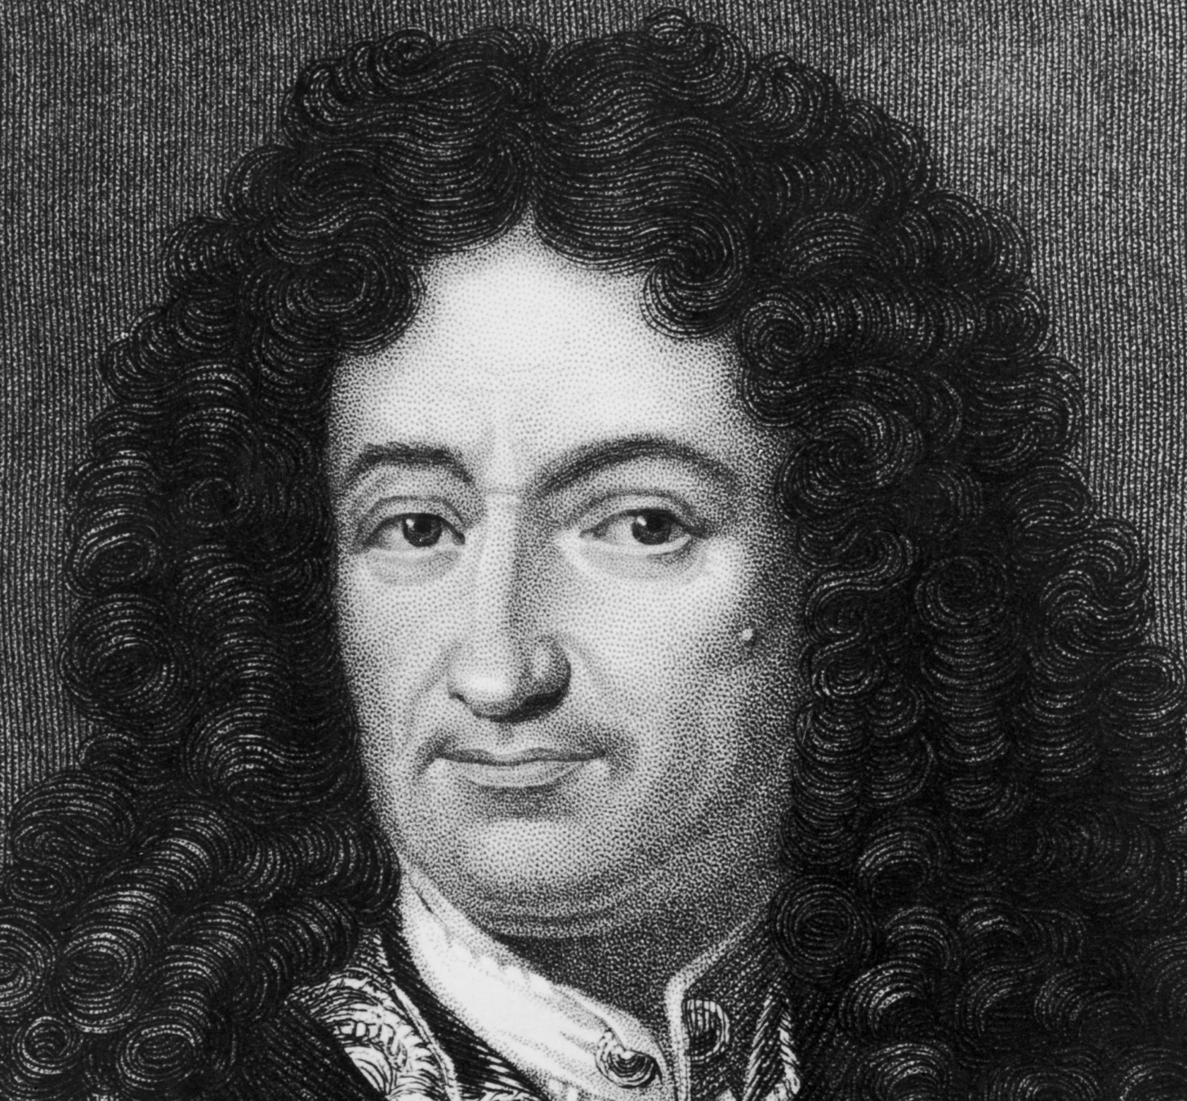
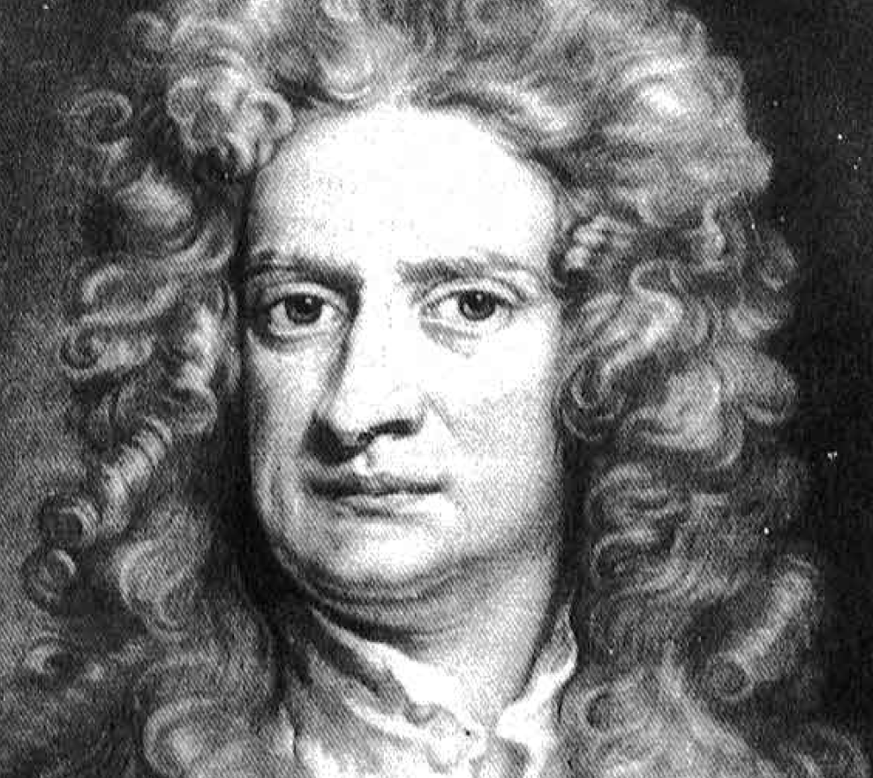
Notes:
# ...and see Gottfried Liebniz and Isaac Newton independently discovering the calculus.
#

Slide 29
1856
Notes:
# And finally...
#

Slide 30
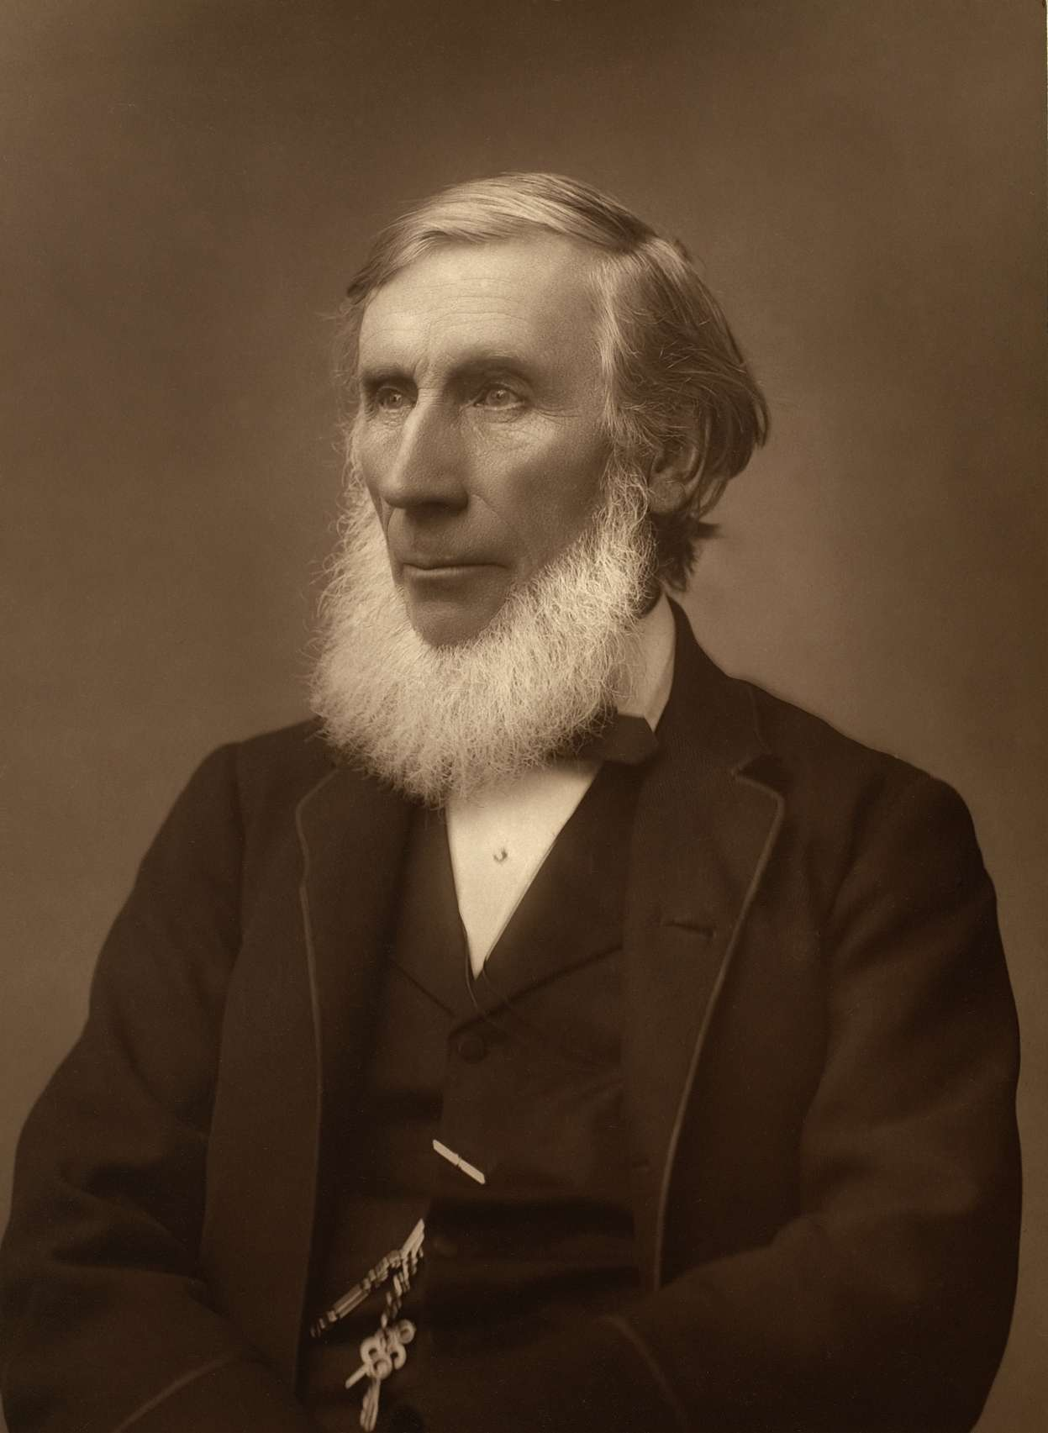
Notes:
# ...we have John Tyndall. He is often credited with first establishing – in 1859 – that carbon dioxide is a greenhouse gas that leads to climate change.
#

Slide 31

Notes:
# Standing in for Eunice Newton Foote, we have the cover of her scientific paper. *She* made and published the greenhouse gas discovery 3 years earlier.
#

Slide 32
Notes:
# Despite her prior publication and also being a signatory at Seneca Falls, the first women’s rights convention, no image of Foote has been found and her discovery was not credited until 2010.
#

Slide 33
Simultaneous Invention
Notes:
# Simultaneous Invention is the concept that certain ideas are “in the air”. The prerequisite inventions have been made and now it just takes a spark of creativity – and a lot of effort – to build the next step in the technology tree. Simultaneous invention is a common occurrence through history.
#

Slide 34
2010s
Notes:
# So now, let’s return to this decade...
#

Slide 35
CNCF Cloud Native Definition v1.0
CNCF Cloud Native Definition v1.0
Cloud native technologies empower organizations to build and run scalable applications in modern, dynamic environments such as public, private, and hybrid clouds. Containers, service meshes, microservices, immutable infrastructure, and declarative APIs exemplify this approach.
These techniques enable loosely coupled systems that are resilient, manageable, and observable. Combined with robust automation, they allow engineers to make high-impact changes frequently and predictably with minimal toil.
The Cloud Native Computing Foundation seeks to drive adoption of this paradigm by fostering and sustaining an ecosystem of open source, vendor-neutral projects. We democratize state-of-the-art patterns to make these innovations accessible for everyone.
Notes:
# ...and the cloud native definition. A number of companies have faced the challenge of building and running applications at scale.
#

Slide 36

Notes:
# And, with the prerequisite technologies having become available – including the Internet and Linux...
#

Slide 37
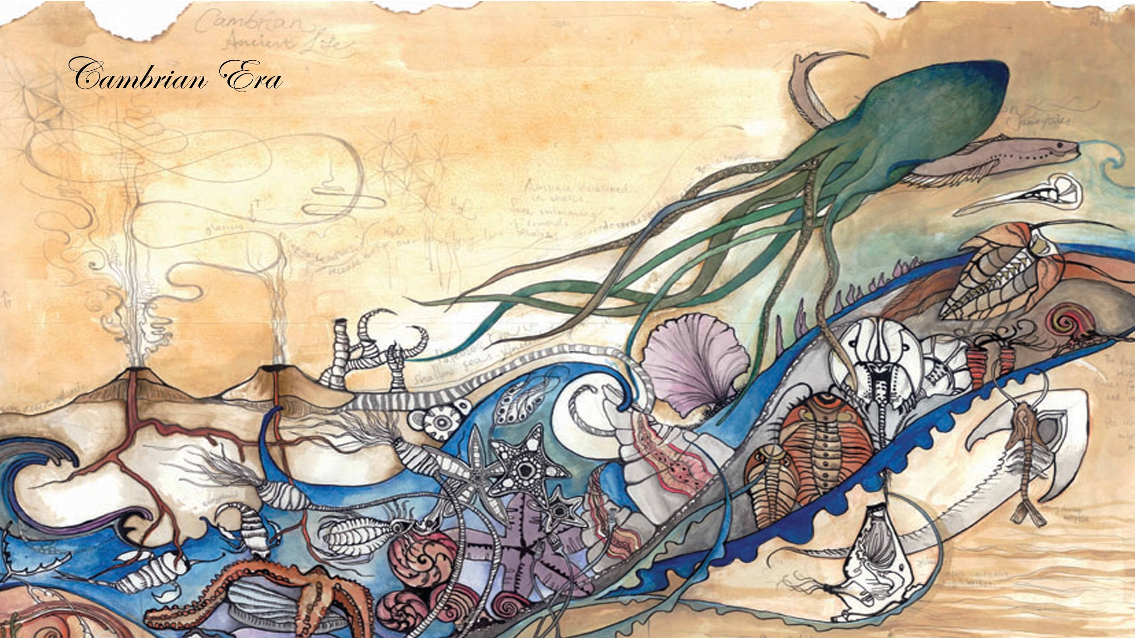
Notes:
# ...a Cambrian explosion of container orchestrators was created. These systems, each of which follow the cloud native definition, enabled these companies to reach web scale with fewer servers and fewer staff than would have been possible before. They include:
#

Slide 38
Alibaba Sigma
CoreOS Fleet
Notes:
[Going very fast through these logos:]
# Alibaba Sigma
#

Slide 39
Amazon Apollo
Notes:
# Amazon Apollo
#

Slide 40
Apache Mesos
Notes:
# Apache Mesos
#

Slide 41
Baidu Matrix
CoreOS Fleet
Notes:
# Baidu Matrix
#

Slide 42
Cloud Foundry Garden & Diego
Notes:
# Cloud Foundry Garden & Diego
#

Slide 43
CoreOS Fleet
CoreOS Fleet
Notes:
# CoreOS Fleet
#

Slide 44
Docker Swarm
Notes:
# Docker Swarm
#

Slide 45
Facebook Tupperware
Notes:
# Facebook Tupperware
#

Slide 46
Google Borg & Omega
Notes:
# and finally... Google Borg & Omega. *No just kidding*, we’re only halfway through. There’s also...
#

Slide 47
HashiCorp Nomad
Hashicorp Nomad
Notes:
# HashiCorp Nomad
#

Slide 48

IBM Platform Symphony
Hashicorp Nomad
Notes:
# IBM Platform Symphony
#

Slide 49
Joyent Triton
Notes:
# Joyent Triton
#

Slide 50
Lyft v3 Infra
Lyft v3 Infra
Notes:
# Lyft v3 Infra
#

Slide 51
Microsoft Service Fabric
Microsoft Service Fabric
Notes:
# Microsoft Service Fabric
#

Slide 52
Netflix Titus
Netflix Titus
Notes:
# Netflix Titus
#

Slide 53
Rancher Cattle
Rancher Cattle
Notes:
# Rancher Cattle
#

Slide 54
Red Hat OpenShift v2 Broker
Red Hat OpenShift v2 Broker
Notes:
# Red Hat OpenShift v2 Broker
#

Slide 55
Spotify Helios
Spotify Helios
Notes:
# Spotify Helios
#

Slide 56
Tencent Gaia
Notes:
# Tencent Gaia
#

Slide 57
Twitter Aurora
Notes:
# Twitter Aurora
#

Slide 58
Uber Peloton
Uber Peloton
Notes:
# And Uber Peloton. So, how were all of these organizations able to develop similar approaches to their scaling challenges?
#

Slide 59
In the Air
Notes:
# You could say that the prerequisite technologies were “In the Air”.
#

Slide 60
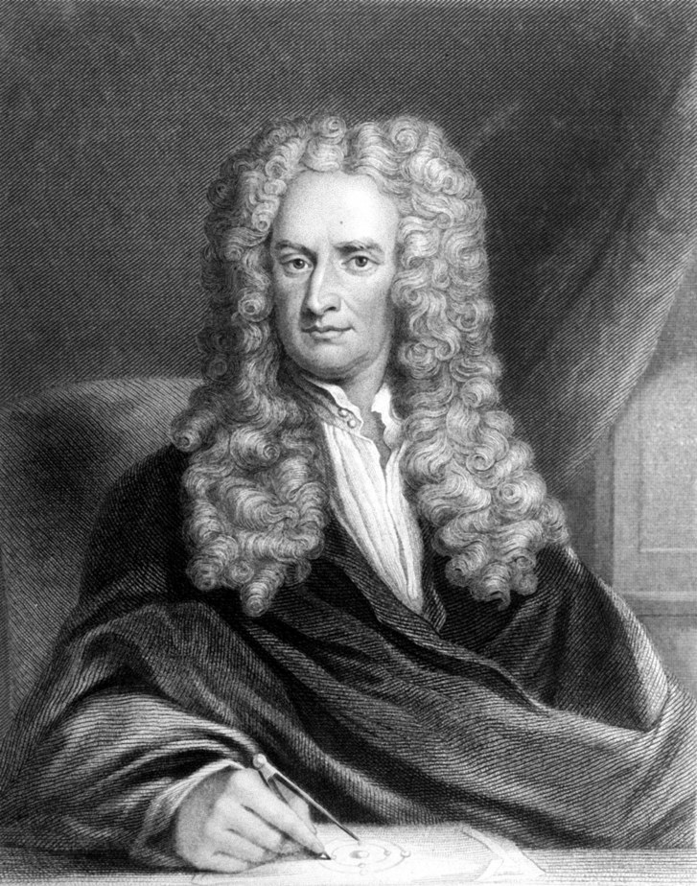
“If I have seen further it is by standing on the shoulders
of giants”
Isaac Newton
Notes:
# As Isaac Newton wrote, “...We stand on the shoulders of giants”.
#

Slide 61
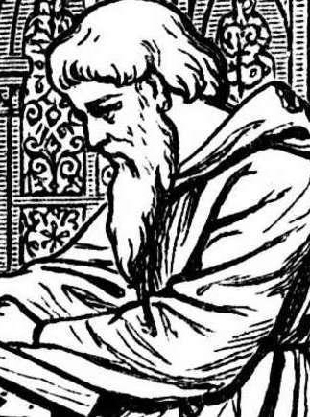
“Bernard of Chartres used to say that we are like dwarfs on the shoulders of giants...”
John of Salisbury
Notes:
# Which is what Newton was doing when he adapted that saying from Bernard de Chartres.
#

Slide 62
Everything is a Remix
Notes:
# Which is what *I* am doing in that I reused those two quotes from the fantastic video essay “Everything Is a Remix”. [pause]
#

Slide 63
2019
Notes:
# But *now* let’s return firmly to the present.
#

Slide 64
Notes:
# We’re all here at KubeCon + CloudNativeCon Barcelona. Many other technologies had to be developed before cloud native could emerge. But why aren’t we at HeliosCon or MatrixCon or ApolloCon?
#

Slide 65
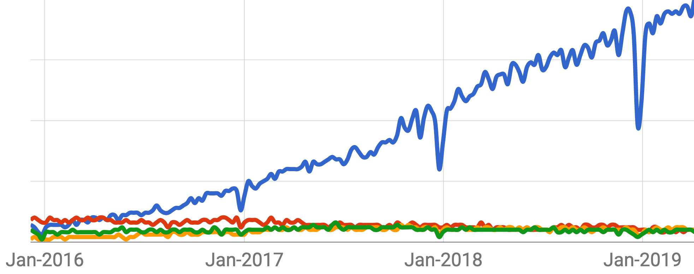
Kubernetes Mesos Docker Swarm Cloud Foundry
Notes:
# These are the results of web searches on some of the open source cloud native offerings over the last 3 years. What is responsible for Kubernetes’s extraordinary growth?
#

Slide 66
Notes:
# Let’s finally try to answer the earlier question, why Kubernetes? In my view, there are 3 main reasons:
#

Slide 67
It Works Really Well
1
Notes:
# Number 1. It works really well. Kubernetes was not just built on a decade of learning within Google from Borg and Omega, but has now also incorporated key architectural ideas from Red Hat, Huawei, and dozens of other companies.
#

Slide 68
Vendor-Neutral Open Source
2
Notes:
# Number 2. Vendor-neutral open source. Enterprises that are going to build on top of a platform want to see multiple companies backing a technology so they’re not locked into a single vendor. No one wants to have to pay a platform tax for the lifetime of their application.
#

Slide 69
Notes:
# From the beginning, Google explicitly encouraged developers from other companies to take leadership roles. In fact, CNCF was created within the Linux Foundation to provide a neutral home for cloud native technologies, and has worked – through programs like Certified Kubernetes – to ensure that the ecosystem does not fragment.
#

Slide 70
It’s the People
3
Notes:
# Number 3. It’s the people.
#

Slide 71
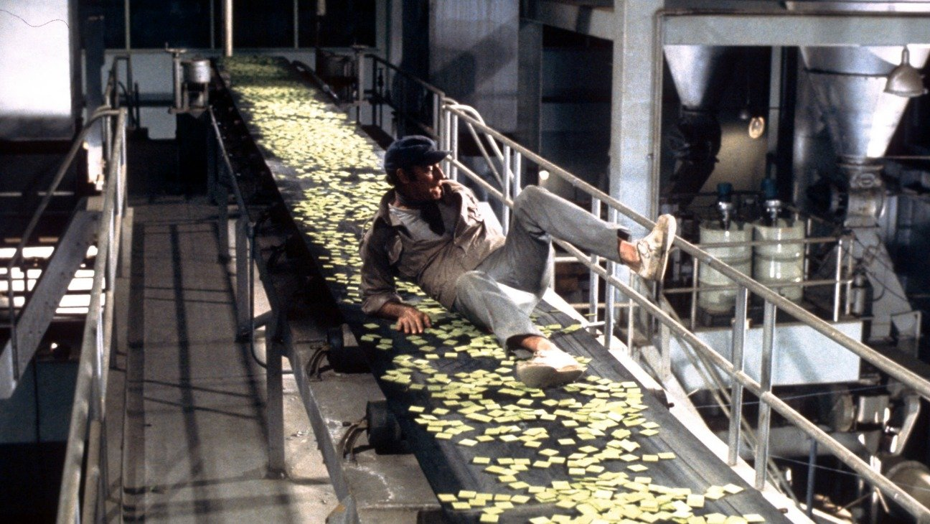
SOYLENT GREEN IS PEOPLE!
Notes:
# Kubernetes, like Soylent Green, is people. [pause] The project has been developed by an extraordinary group of contributors, has done an impressive job onboarding new users (what has been called the “time to first serotonin”)...
#

Slide 72

Notes:
# ...and has explicitly worked to *narrow* the distance between the steps of the contribution ladder – from user to contributor to reviewer to *leader*. We’ll be hearing from two early-in-their-career leaders on this stage in the next hour.
#

Slide 73
It Works Really Well
Vendor-Neutral Open Source
It’s the People
1
2
3
Notes:
# So these are my ideas on the 3 reasons for success, but I’d love to hear yours, either in person here at the conference or on Twitter. And the thought I want to leave you with is how deliberate all 3 elements of Kubernetes’s success have been. To quote the climate writer David Roberts:
#

Slide 74
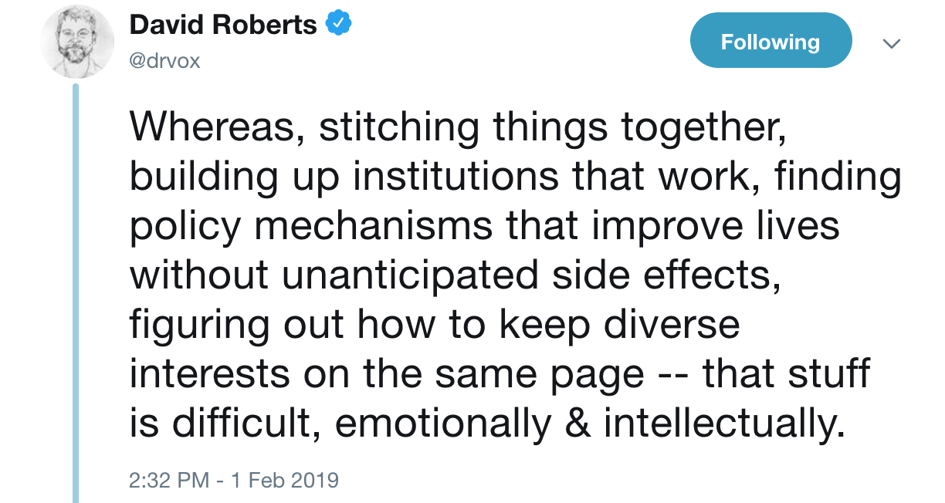
Notes:
# “...Stitching things together, building up institutions that work, figuring out how to keep diverse interests on the same page – is difficult, emotionally and intellectually”.
#

Slide 75
Notes:
# The magic of the technology tree is that we can only be here because our predecessors have developed extraordinary innovations – like Linux, and TCP/IP and – in a bigger sense, evolution, the calculus, and the cause of climate change.
#

Slide 76
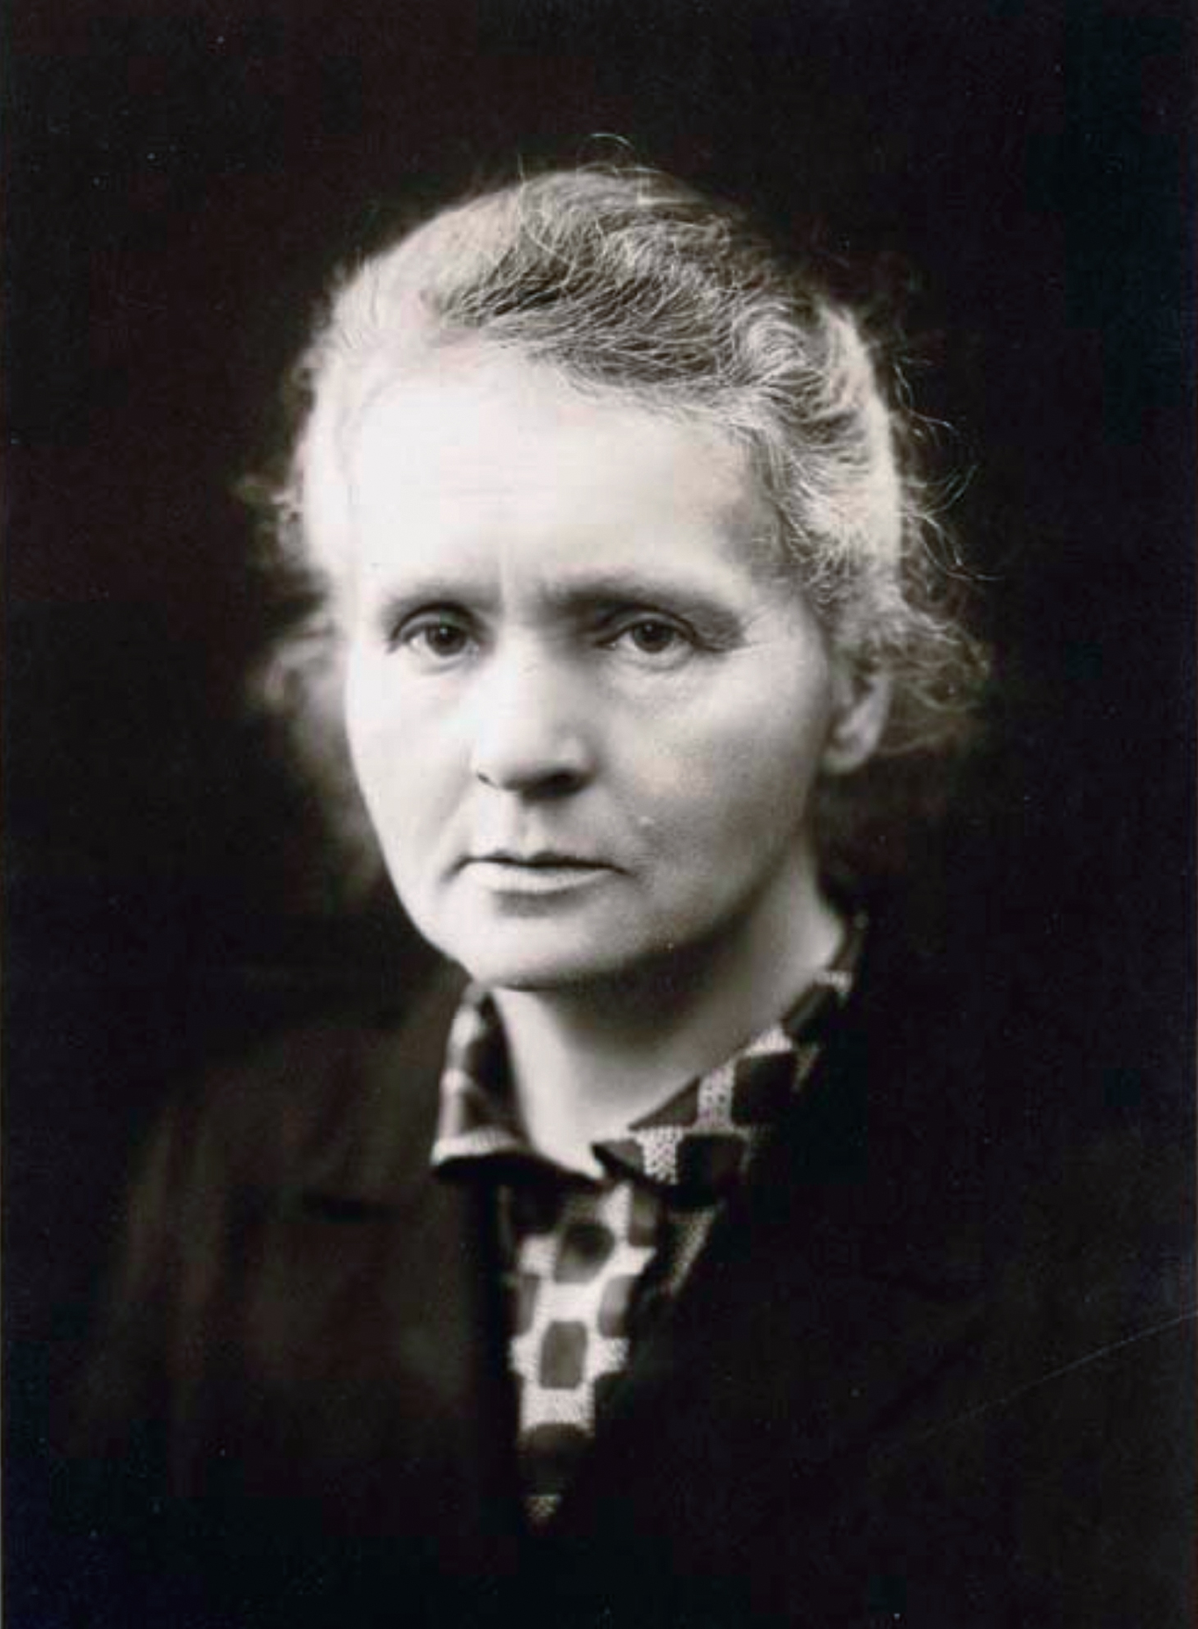
“The way of progress was neither swift nor easy”
Marie Curie
Notes:
# And the work that we’re doing here together this week – building on top of the shoulders of giants – may be neither swift nor easy...
#

Slide 77
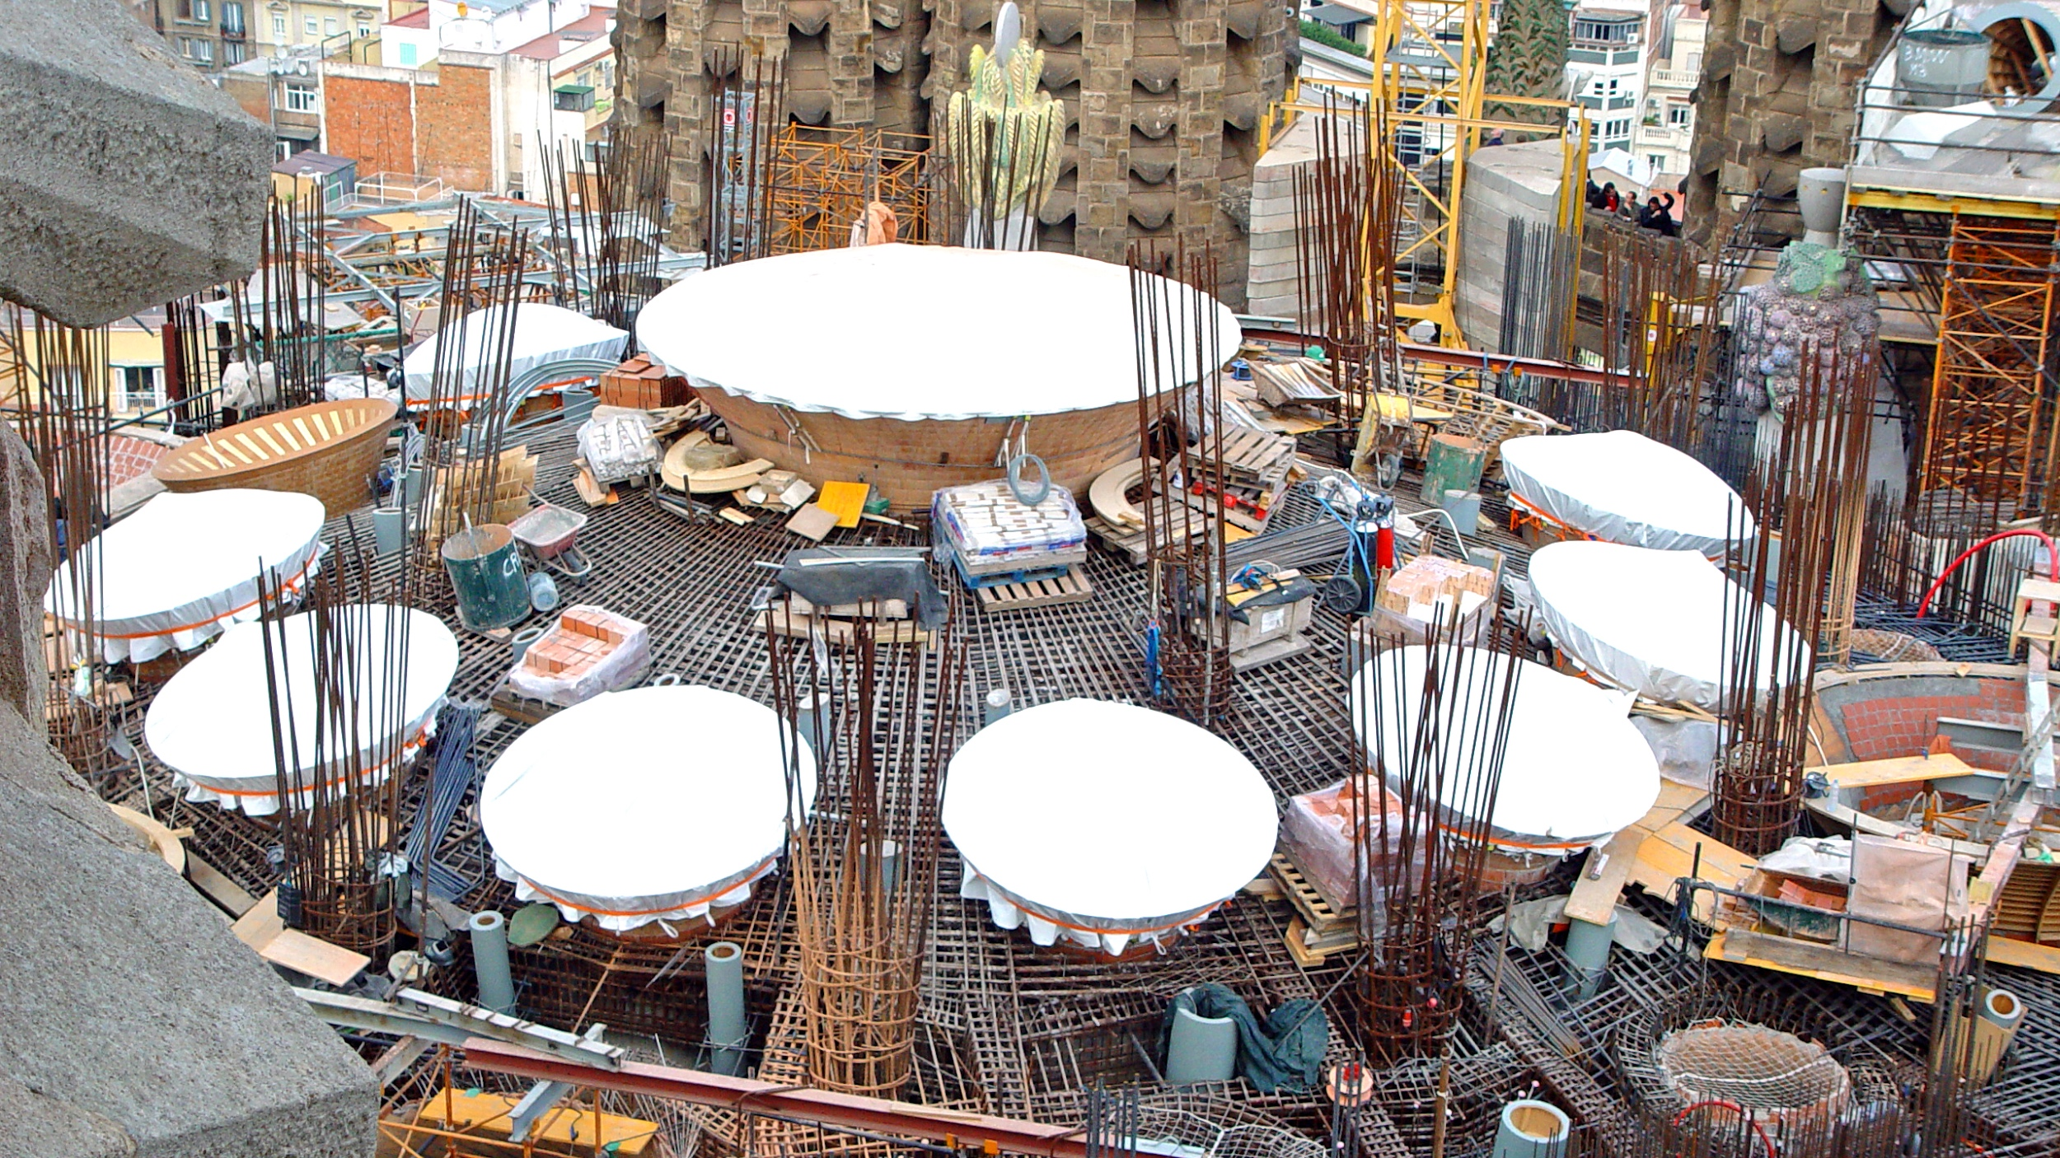
Notes:
# ...but it is also laying the foundations of the next generation of innovations, which are even now being built on top of Kubernetes.
#

Slide 78
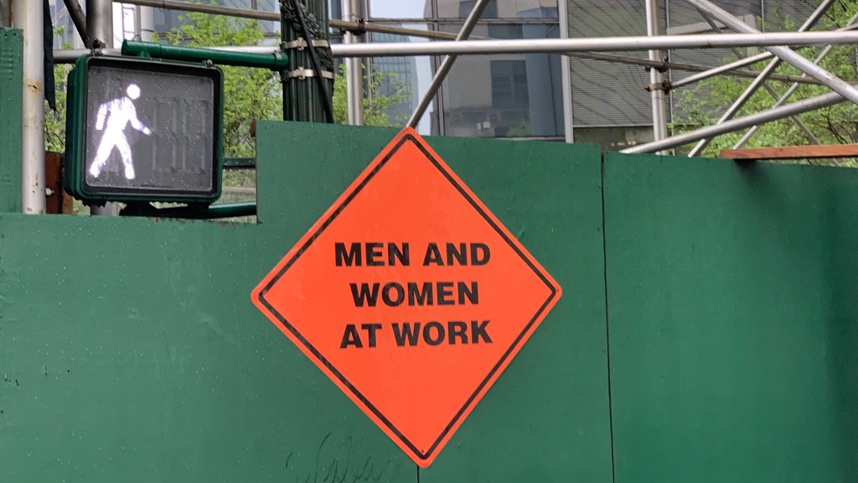



Notes:
# We – all of us – are part of the cloud native community. [pause] I entreat us to collaborate together – in a spirit of *kindness* and with an awareness of *history* – this week and hereafter.
#

Slide 79
Thank You
@dankohn1
Notes:
# Thank you very much.
#

Slide 80
Endnotes
Slate: The Other Social Network by Christopher Beam
Technology Trees by Tuur Ghys
Quartz: Simultaneous Invention
The Myth of the Sole Invention by Mark Lemley
New Yorker: In the Air by Malcolm Gladwell
Smithsonian.com: This Lady Scientist Defined the Greenhouse Effect by Leila McNeil
ACM Queue: Borg, Omega, and Kubernetes
Everything is a Remix, Episode 2
Gaudi’s Sagrada Família
David Roberts tweet

